Slide 1
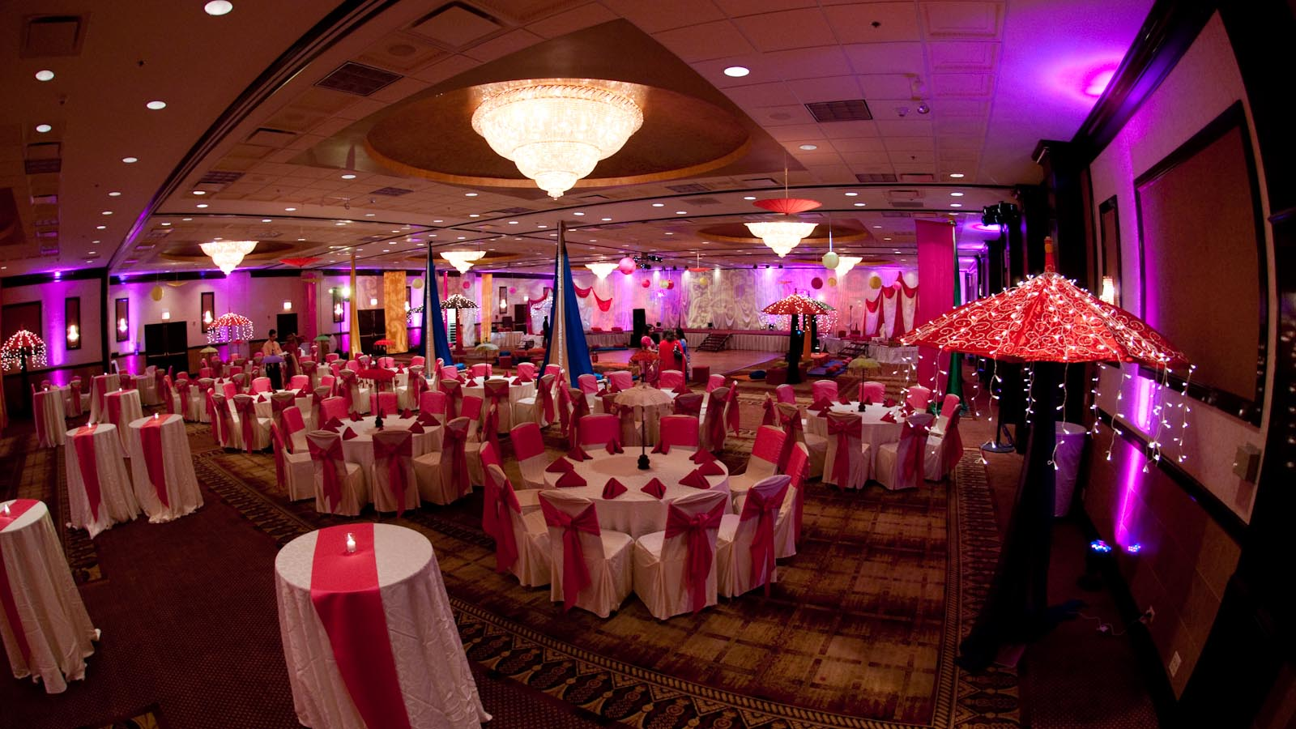
Eventivo
Supervised By:
Mr. Zafar Iqbal Roy

Slide 2
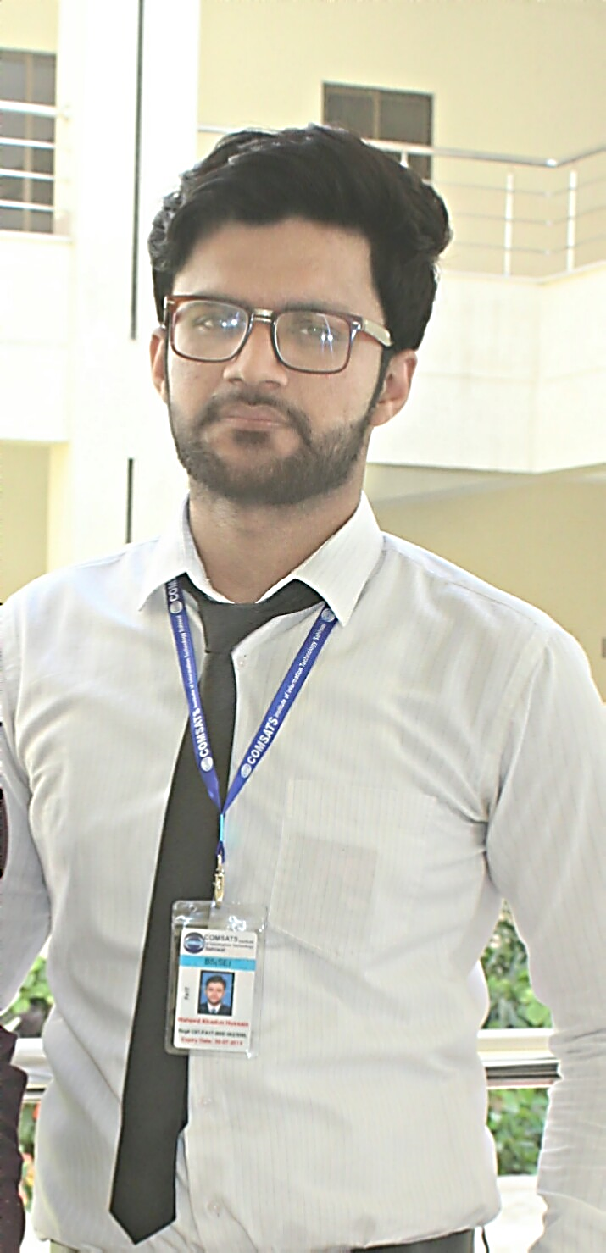
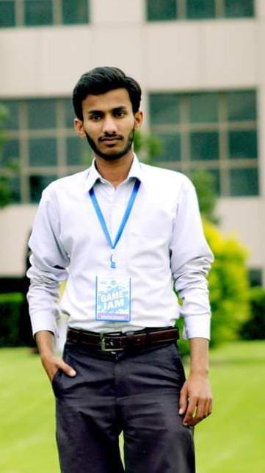
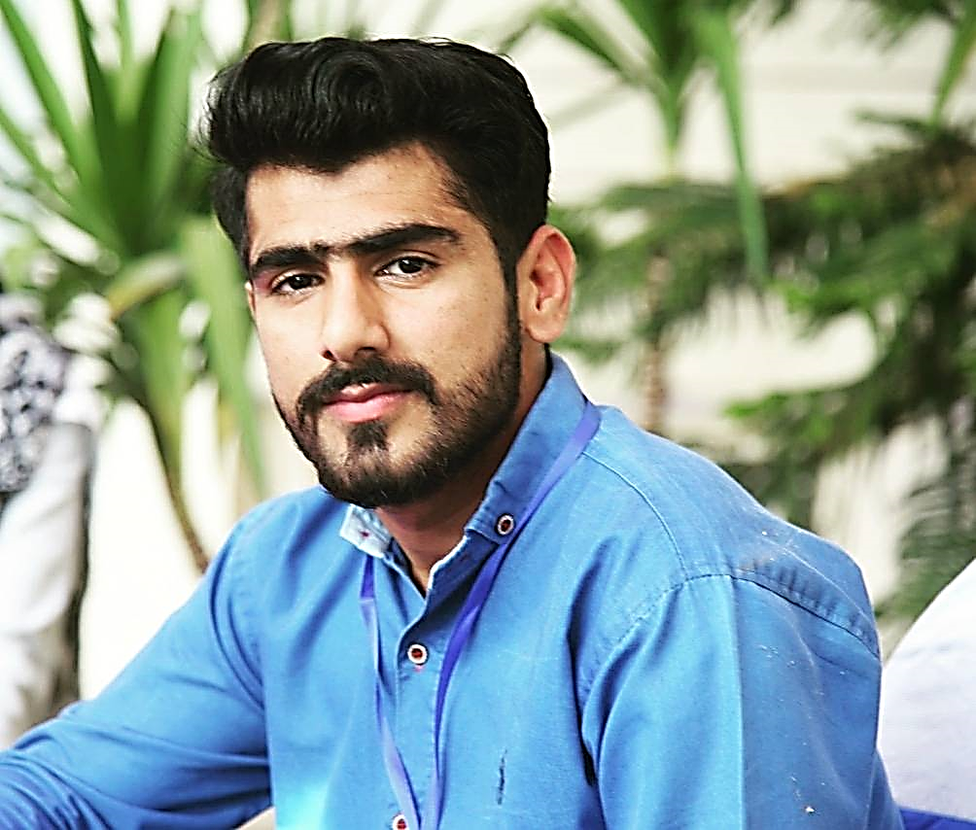
Group Members:
Waheed Khadim Hussain FA17-BSE-062
Tariq Hussain FA17-BSE-060
Hafiz M. Asif Afzal FA17-BSE-075

Slide 3

Introduction
Digitalization of World.
More technology, more easiness people want.
People don’t want manual things now.
Introducing the Eventivo
Origination of idea (background information)
64% young population in Pakistan.

Slide 4

Problem Statement
Manually selection of halls is very time-consuming.
People lower their choices through manual visits.
They visit the main ones only.
People don’t know the better one.
People don’t have all information on one click.
Notes:
Information: Food Quality, Sitting capacity, sound system, decorations etc.

Slide 5

Solution?
Eventivo App
Android Based

Slide 6

What Will Eventivo Do?
All information about each halls on one click.
User can access, search and contact all nearby halls.
Food ordering
Sitting Capacity
All other arrangements on a single application.
User can do booking
User can estimate the cost without contacting them.
It will suggest/compare different venues

Slide 7
Advance Features
The system will suggest the Venues with help of NLP (semantic analysis)
The system shall allow the user to chat with the manager

Slide 8
Project Scope
Through Eventivo:
User can book all the function’s essential by sitting at home or any location.
User can be able to compare different venues.
The system will give suggestions according to the budget and number of people so user can view them according to his needs.
The seller will be able to get more customers by creating the venue’s profile and can add all details about venue on profile.

Slide 9

Architectural Design

Slide 10
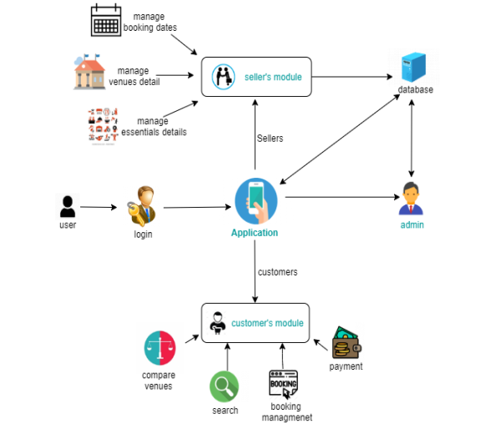

Slide 11
Methodology?
Incremental Model

Slide 12
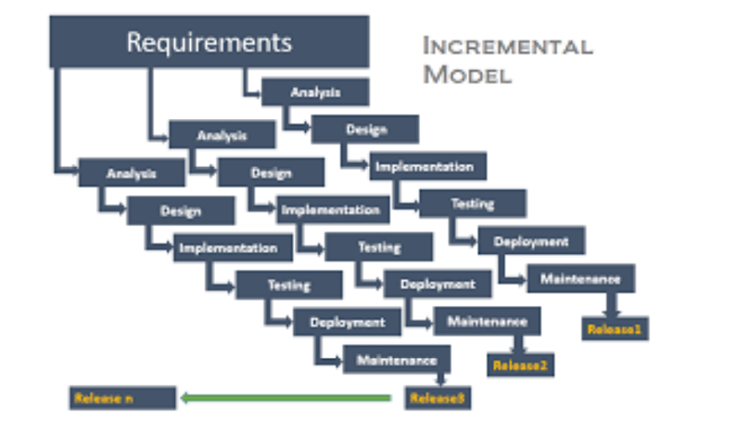

Slide 13

Tools & Technologies
Tools
Android Studio
Photoshop
Pycharm
Technologies
Java
Python
Firebase

Slide 14

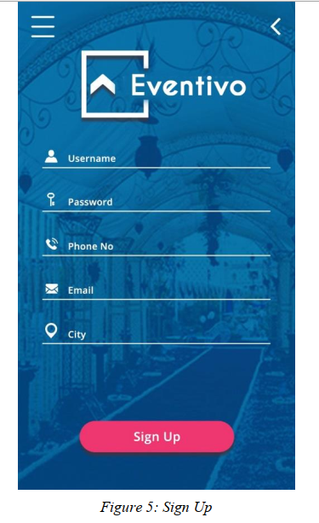
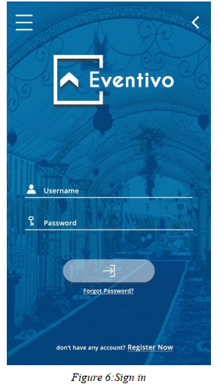
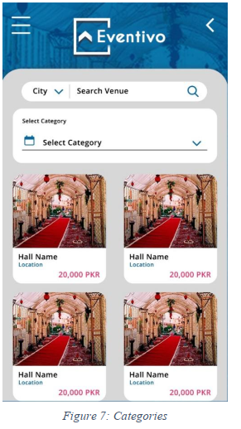
APP Structure

Slide 15
RELATED SYSTEM ANALYSIS
VenueHub.pk
It’s just for Lahore city
Unable to purchase services according to your needs
No Suggestions option
VenueBazaar.pk
It’s only providing services in Karachi city
Not giving any option about comparison of venues
No feedback or review option
No category wise services option

Slide 16
Conclusions
The implementation of Eventivo android Application is successfully discussed.
A Eventivo Application provides the searching facilities based on various factor. This android app will provide an interface for searching wedding halls and marquees on a particular day.
User can save time and money to search for hall

Slide 17
Thank You!

